Slide 2
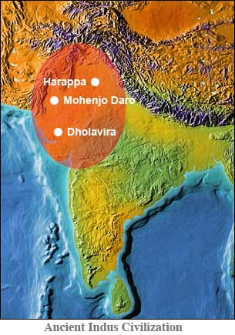
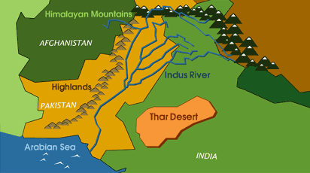
Where is the Indus valley ?
The Indus Valley is on the border between India,Pakistan and Afghanistan.
To the West of Mohenjo-Daro are the Highlands. North East of Mohenjo Daro are the Himalayan mountains.
Desert in the east (thar Desert) which both provided natural defense from invasions

Slide 3
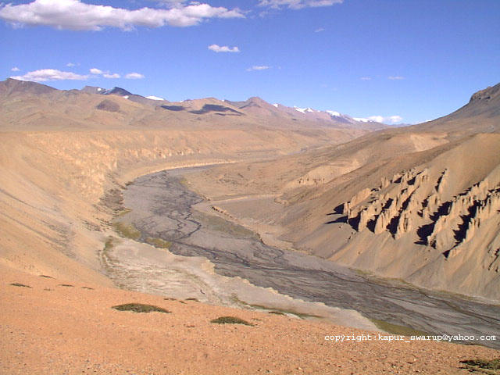
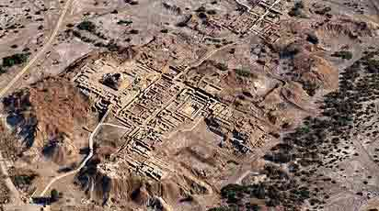
The Civilization in the IndusValley
The Indus Valley civilization lived in the Valley about 4000 years ago in the western part of South Asia, in what today is Pakistan and western India.
The people in the Indus valley formed the earliest urban civilization in the sub Indian continent and one of the earliest in the world.
Another name for the Indus valley civilization is the Harappan civilization.
The first excavations that were made in the cities of Harappa and Mohenjo-daro which were conducted in 1921-1922 by Alexander Cunningham.
Many different artefacts have been uncovered in the Indus Valleys main cities, Mohenjo-Daro and Harappa.

Slide 4
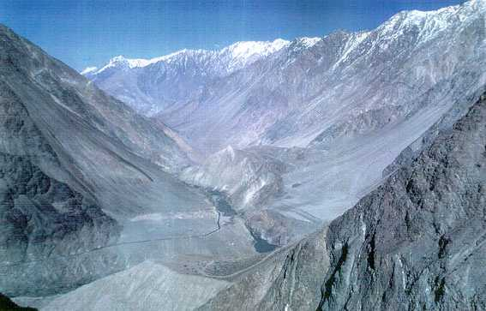
Why did the Harappan civilization decide to live in the Indus Valley?
The Indus Valley civilization may lived there because of the Indus River which flows through the valley.
It over-flowed every year leaving soil perfect for growing crops in.
It could of also been used for transport and food such as fish.
The Indus Valley was also well protected by the Himalayan Mountain Range.

Slide 5
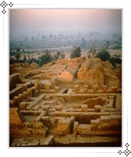
Streets and Buildings
The City Structure
Harappa and Mohenjo-daro were remarkably similar in layout and construction. Both were built on a square grid pattern
To the west is citadel or raised area.. In Mohenjo-daro, the citadel is built about 45 feet above the plain.
The city was laid out in grid iron with main streets about 45 feet wide.
Main streets ran from north to south and east to west intersecting each other.
Carts ran down to transport goods. These where pulled by camels, oxen and elephants, which where also used to travel on.

Slide 6
Built Houses
The nature of the buildings shows that the town dwellers were divided into social classes.
The rich and the ruling class lived in multi roomed spacious houses and poorer lived in small tenants.
Encroachment on public roads was not permitted.
Smaller houses had two rooms while larger houses has many rooms. There courtyards attached to big buildings.
Many of the houses had baths, wells and covered drains connected with street drains.
Buildings had little ventilation arrangement, as door and windows were rarely fixed in the outer walls
Entrance door facing the lane.

Slide 7
Built Houses
The houses were built on plinths rising above the street level with steps recessed in the wall at the front door.
Brick houses of one to three stories were jumbled together in these areas, which must have been densely populated.
The layout of the houses was amazingly uniform in that each consisted of a courtyard surrounded by rooms for sleeping, cooking, and, in the larger homes, receiving visitors.
Each of the homes had a bathing area and drains that emptied into a covered, citywide sewage system, which was the best in the ancient world.

Slide 8
Building Materials
There were no stone built house in Indus cities.
Most of the houses were built of burnt bricks. But sun dried bricks were also used.
Most of the bricks were equal in size.

Slide 9
Citadel Of Mohenjo-Daro
The existence of a strong ruling class is also indicated by the presence of large and well-fortified citadels in each of the capital cities.
These citadels served as sanctuaries for the cities' populations in times of attack and as community centers in times of peace. The citadel at Mohenjo-daro included a very large building that may have been a palace.
It was used for public gathering and religious gathering.

Slide 10
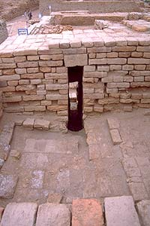
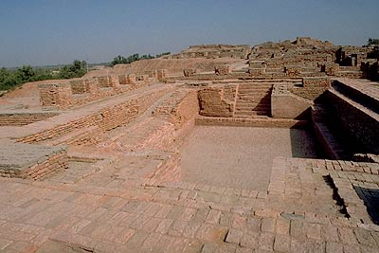
The Great Bath
The great bath was a special place in the Indus Valley. Like the drains, the bricks were made waterproof so none of the water could escape. The only way the water could escape was through a special system where, if they wanted to, they can let the water out if it got to dirty and then they could fill it up again. It also has a plug hole which was used for totally emptying out the bath.
The bath is made from tightly fitted bricks which had tar on the inside of the bath. The tar was used as a water proof layer so the people could bath. Archaeologists aren’t sure how they filled it up but they found a well near by.
The bath was 12 metres long and 7 metres wide.
This is the plug of the great bath.
This is the great bath today

Slide 11
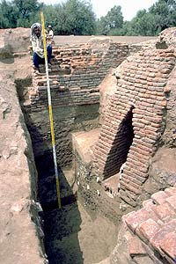
The Drainage System
The Indus civilization had an elaborate sanitary and drainage system.
Each and every house had a connection with the main drain. These even had inspection holes for maintenance.
There is evidence of very sophisticated drainage systems in the cities of the Indus Civilization. The drainage systems were so big that a human would have been able to walk through the middle of one.
If the drain was blocked, the drain could be easily accessed. They were also very clever because they used cement and clay bricks to make the drains. It was 5 metres deep.

Slide 12
The conduit to the main drains running through the middle of streets below pavement level and covered with stones and bricks.
The covered drain was connected to the larger sewerage outlets which finally led the dirty water outside the populated areas.
They introduced world’s first urban sanitation system

Slide 13
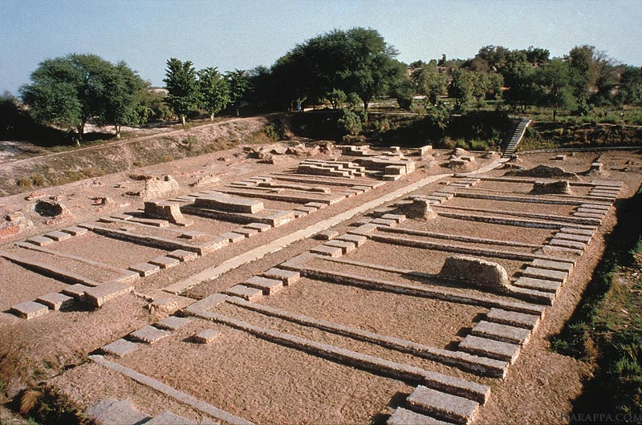
Granary
A granary is a structure for the storage and preservation of grain, and the people of Mohenjo-Daro had a big one.
The people of Mohenjo-Daro may have used their granary as a community bank for their harvested grains, much as we use banks today.
Stored grain for Ceremonial purposes, times of shortage, and possibly the regulation of grain production and sale.

Slide 14
The great cities and many towns of the Indus valley civilization were supported by a rather advanced agricultural system based on the cultivation of wheat, rye, peas, and possibly rice. Cotton was widely cultivated and numerous domesticated animals were reared.
It is likely that irrigation systems were built to catch and control waters from the monsoon and the rivers, and that fish caught in the rivers provided an additional nutritive essential.

Slide 15
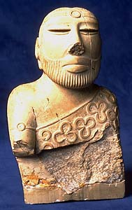
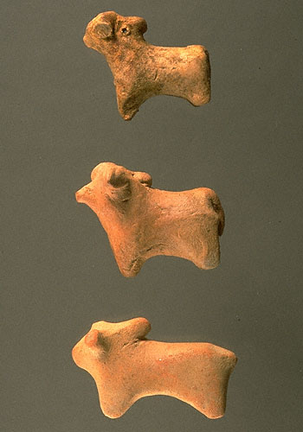
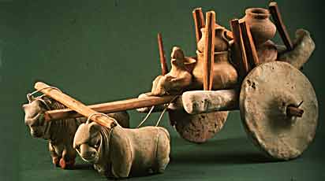
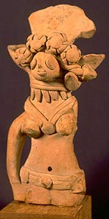
Models and Figurines
Many archaeologists think that Harappan people used figurines when they prayed. Maybe the Harrapan people worshiped a female goddess.
Dice and small sculptures of bullock carts were probably used as toys and games.

Slide 16
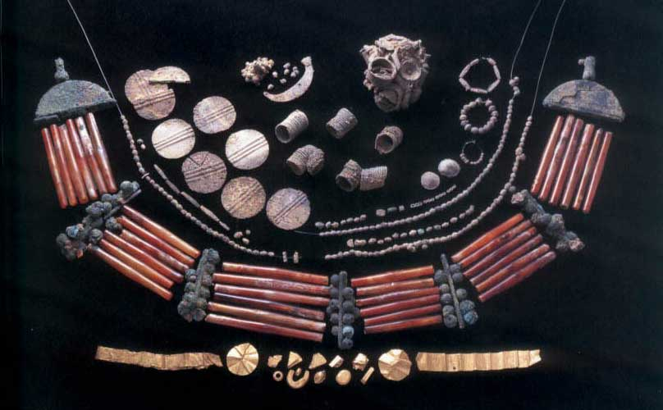
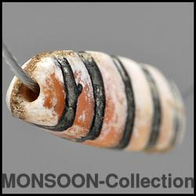
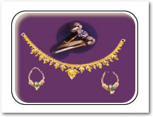
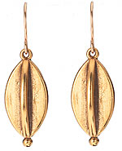
Indus valley’s jewellery
People of the Indus Valley really loved jewellery and it is one of the Indus valley civilization best feature. We have evidence of the amount of jewellery found in the Indus valley.
The Indus valley is rich in many metals and worthy stones such as Carnelian, gold, copper, turquoise and other metals/semi precious stones
Each bead in the Indus valley is approximately 2-3 centimetres long.

Slide 17
Name three theories about why the Indus valley civilization ended?
The river may have changed course, natural disaster (Caused by heavy monsoons)
The people may have overworked the land (overcutting trees, over grazed, over farmed land depleting nutrients.
Aryan invasion

